Slide 1
How warm will it get? Scenarios of global warming
Diese Präsentation wurde von EPIZ e.V. im Rahmen des Projekts Global Fairness – Schools as Agents for Change entwickelt.
Sie darf für Bildungszwecke genutzt werden und ist Teil des Unterrichtsmaterials „Ein Klima für den Wandel“.

Slide 2
The Present From the era of industrialization until today
The percentage of carbon dioxide in the atmosphere has increased by one-third compared to the beginning of industrialization.
The global climate has warmed up by 0,8°C since industrialization.
http://globalcarbonatlas.org/?q=en/outreach

Slide 3
The Present From the era of industrialization until today
Climate change is happening right now and consequences are already visible in droughts, floods and other impacts on the eco-system, which are causing famines or forced migration.
Politicians and international accords are focussing on limiting global warming to + 2°C in comparison to levels before industrialization.
But...
Is this enough?
Why 2 and not 3, or 4 (or less..?)?
Which projections do scientists make for global warming at 2°C?

Slide 4
General consequences of global warming
Extreme weather conditions, such as heat waves
Floods and droughts
Extinction of species of flora and fauna
Death of coral reefs
Harm to and loss of eco-systems
Health risks (e.g. increasing of viral infections)
Human insecurity: threatening of livelihoods by “natural” catastrophes, impairment of agriculture, etc.
Forced migration
Economic loss
Reaching of the first “tipping points”-> irreversible consequences

Slide 5
The “+2°C Szenario” Overview:
Scientists say that global warming must be limited to +2°C if the world is to be able to cope with consequences.
By 2050
Calculations are only approximations.
CO2-emissions must be reduced by 50% compared to 1990 levels.
Beyond +2°C, tipping points will be reached.

Slide 6
What are tipping points?
Tipping points are critical turning points in global warming: if they are reached, consequences will be irreversible, severe and of global impact.
Tipping points are the most sensitive parts of our eco-system
The rise in global temperature may be small. However, if a tipping point is reached, consequences are abrupt and huge.
After the crossing of a tipping point, the global climate will have suffered long-term damage.

Slide 7
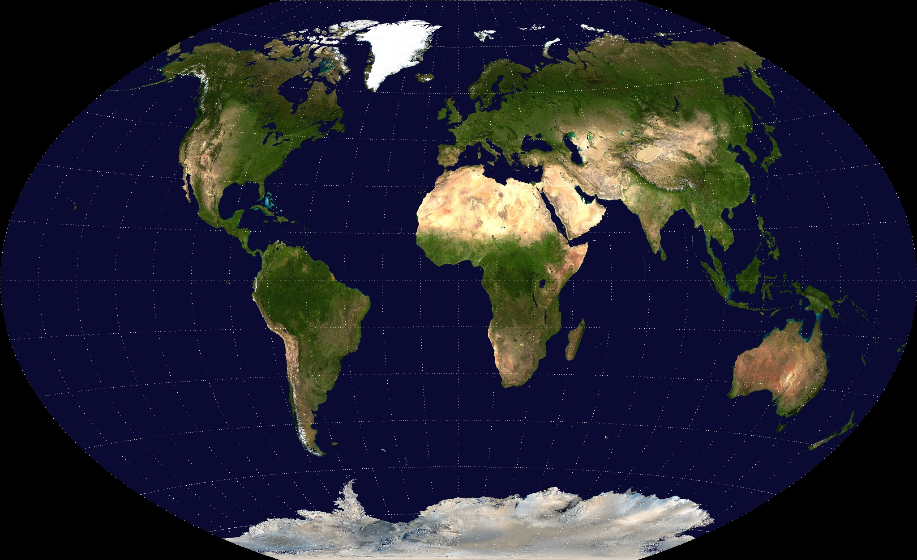
Tipping Points
Arctic Ice Sheet
Greenlandic Ice Sheet
Permafrost
Boreal coniferous forest
North Atlantic Current
Himalayan glacier
Sahelzone
El Niño
Amazonia
West Antarctic Ice Sheet
Quelle Weltkarte ohne Inhalt:
Winkel-tripel-projection“. Lizenziert unter Gemeinfrei über Wikimedia Commons
0.8°-2°C
2°-4° C
4°C <

Slide 8
Tipping points
+2°C szenario
0.5°-2°C : Arctic sea ice/Ice Sheet
Rise of sea level, serious consequences for humans and for the eco-system
Absorption instead of reflection of sun rays, which intensifies warming

Slide 9
Tipping points
+2°C szenario
1°-2°C Greenlandic Ice Shield
The melting of the ice shield will cause a 0,5 m rise of sea level by 2100.

Slide 10
Tipping points
+2°C szenario
1°-3°C Himalayan Glacier
Melting increases global warming through absorption of sun rays.
Floods followed by shortage of water supplies in Nepal, Bhutan, India, Pakistan and China

Slide 11
Tipping points
+2°C szenario
2°-4°C The Amazon Rainforest
In addition to the destruction of rainforest by the clearing of land, warmer temperatures will lead to the death of 40% or more of the rainforest.
This will not only have dramatic consequences for human population, flora and fauna, it will also release the CO2 stored in the trees and thus lead to an increase in global warming.

Slide 12
Tipping points
+4°C szenario
2°-4°C The West Antarctic Ice Sheet
Melting of the ice sheet will cause to ocean to rise by 0,5 m by 2100.
Less reflection > more absorption > more warming

Slide 13
Tipping points
+4°C szenario
3°-6°C Boreal coniferous forest
North American, European and Asian forests (one- third of all forests worldwide)
CO2 which is stored in trees will be released.

Slide 14
Tipping points
+4°C szenario
3-5 °C North Atlantic Current
The current is responsible for the mild Northern and Western European climate.
Melting ice leads to the weakening of the Current.
European climate cools down, sea level rises about 1 m.

Slide 15
Tipping points
+4 °C szenario
3-6 °C El Niño
El Niño is a complex weather pattern which results from variations in ocean temperatures.
While it can cause floods in South America, it can provoke droughts in Australia and Southeast Asia.
Global warming will make El Niño weather phenomena more frequent and its impacts stronger.

Slide 16
Tipping points
+4°C szenario
3-5 °C Sahelzone
The weakening of the Atlantic Current will also have impacts on monsoon patterns in Western Africa.
Those shifts are likely to make the Sahel desert expand and make other parts of it fertile.

Slide 17
Tipping points
+4°C szenario
9 °C < Permafrost soil
Permafrost soil is a permanently frozen layer of earth which is mainly located in Russia, Alaska, Canada and China.
The entire extent of the permafrost covers a territory as large as Europe.
As CO2 and methane are stored in permafrost soil, its thawing would have dramatic consequences.

Slide 18
Criticism concerning the +2°C limit
The Climate Vulnerable Forum in Manila is a group of 20 countries which are particularly vulnerable in terms of climate change, such as Kenya, Vietnam and Bangladesh. They believe that the rise of global temperature by 2°C is too much. They say that 2°C will already have serious impacts on human rights and would condemn millions of people to misery.
Many scientists think that the +2°C goal is too optimistic and is not likely to be reached, considering present international and national politics and insufficient efforts to limit emissions. The only way to achieve it would be a radical and immediate reorganization of economies and energy production.

Slide 19
...think ahead: reflection & discussion
Discuss the following questions:
Why do scientists advocate for the +2°C limit?
“Instead of focussing on adaption to climate change, politicians should finally take real steps to prevent it.”
Comment on this statement: Do you think it is possible to limit the rise of global temperature to +2°C by 2050?
If you would like to, you can also go back to the beginning of this presentation and discuss the cartoon.

Slide 20
Quellen
http://www.germanwatch.org/klima/gkkt.pdf
www.wwf.de/fileadmin/fm-wwf/Publikationen-PDF/120103_Klimawandel.pdf
http://www.taz.de/!159617/
https://www.germanwatch.org/de/5922
http://www.klima-sucht-schutz.de/klimaschutz/klimaschutz/das-2-grad-ziel/

